Slide 1
Incorporating Signals into Optimal Trading
Authors: Charles-Albert Lehalle and Eyal Neuman
https://arxiv.org/abs/1704.00847

Slide 2
Main Contribution
Develop a rigorous mathematical framework for optimal execution that:
Integrates short-term predictive signals (e.g., order book imbalance)
Accounts for transient market impact
Solves a stochastic control problem to minimize execution cost

Slide 3


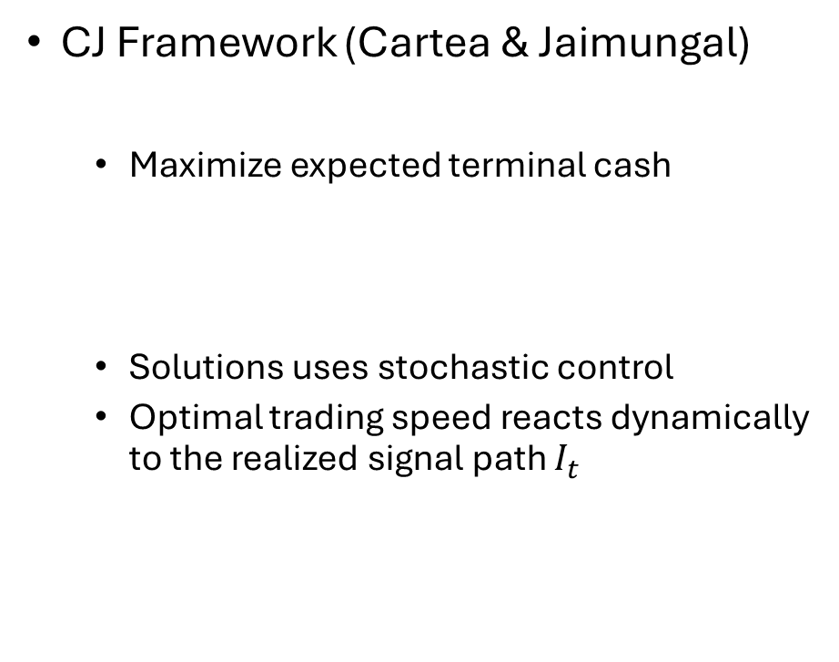
Optimal trading frameworks
GSS Framework (Gatheral, Schied, Slynko)
Transient market impact
Price process is unaffected by external signal
Focus on minimizing expected execution cost and risk
Objective:
CJ Framework (Cartea & Jaimungal)
Maximize expected terminal cash
Solutions uses stochastic control
Optimal trading speed reacts dynamically to the realized signal path $I_{t}$

Slide 4




Signal with GSS
Price process P
Visible price $S={\left\{S_{t}\right\}}_{t≥0}$ is affected by a transient market impact
Cost function
execution cost
risk

Slide 5

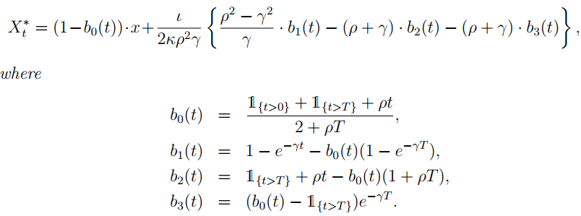

Result for an Ornstein-Uhlenbeck Signal
Ornstein–Uhlenbeck process
Assume that $φ=0$ and $G\left(t\right)=κρe^{−ρt}$, there exists a unique minimizer $X^{∗}$

Slide 6
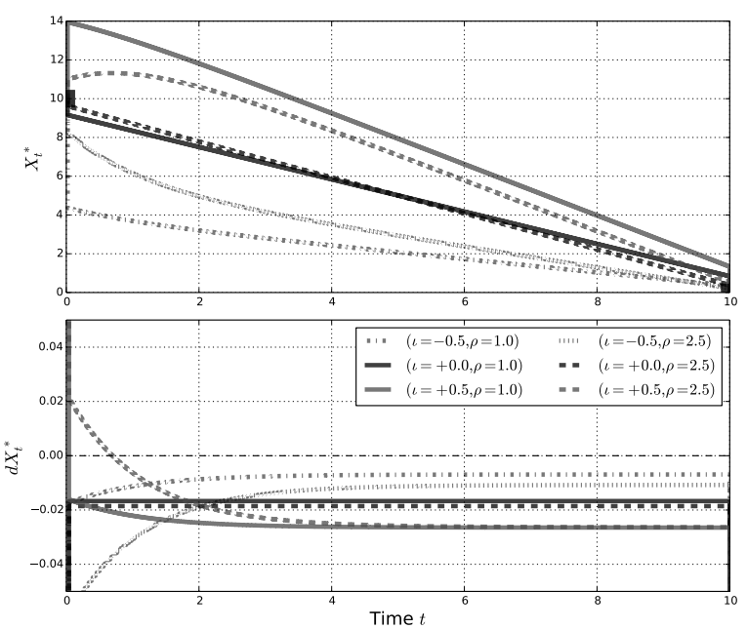
Example trading curve

Slide 7


Signal with CJ
Price process with predictive signal:
Temporary market impact, the execution price is:
Objective function
cash
risk aversion penalty
terminal penalty

Slide 8


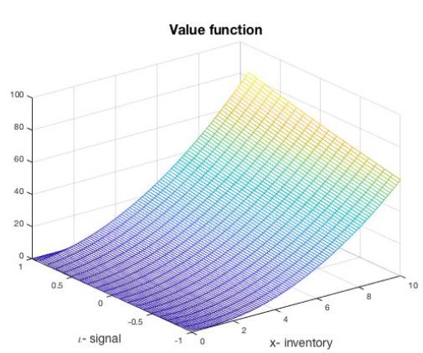
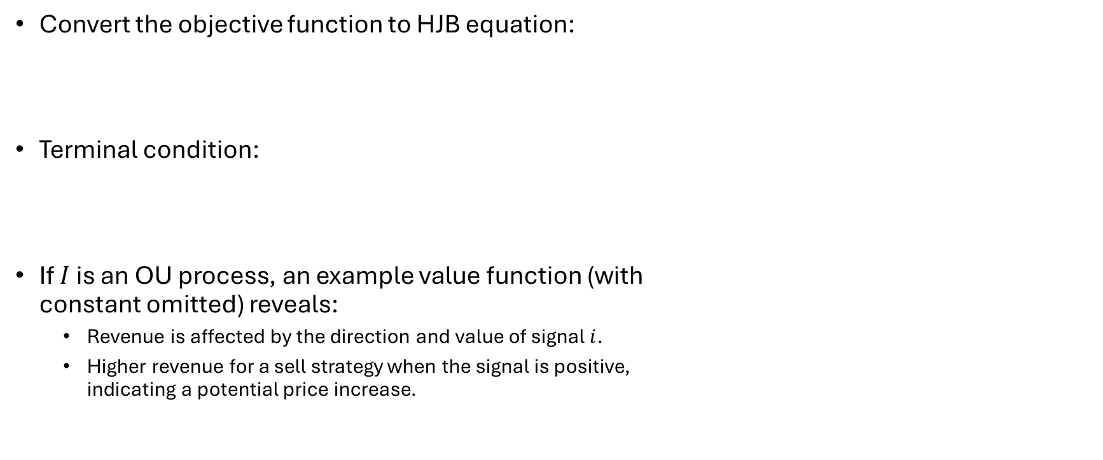
stochastic control solution
Convert the objective function to HJB equation:
Terminal condition:
If $I$ is an OU process, an example value function (with constant omitted) reveals:
Revenue is affected by the direction and value of signal $i$.
Higher revenue for a sell strategy when the signal is positive, indicating a potential price increase.

Slide 9
Summary
Using signals improves the timing and efficiency of trades when compared to purely schedule-based strategies.
GSS and CJ models can be unified and extended using signal-driven dynamic programming.

